Slide 1
Consultation Paper on Good Practices on transfers of supplementary pension rights
Alexandra de Jong
OPSG
10 March 2015
Frankfurt

Slide 2
Outline
Background
Main findings
Discussion

Slide 3
Background

Slide 4
Background
Call for Advice from COM (June 2014)
Consultation Paper published on 29 January 2015 (DL 10 April 2015)
Respond to COM by end July 2015

Slide 5
Work by EIOPA
Assessment of factual information
Report on “Good Practices” facilitating transfers
=>Good Practices = existing legal rules or market practices
EIOPA has no ambition to:
Judge/comment on whether transferability of pension rights is desirable
Aim for harmonisation of national Social and Labour Law

Slide 6
EIOPA Expectations
Answer to COM Call for Advice => inform future debates
Good Practices to be an inspiration to
MS when transposing Directive 2014/50/EU
All stakeholders wishing to improve conditions for transfers

Slide 7
Main findings

Slide 8
Main findings
differences across EU:
Conditions for transfers of pension rights
The extent of use of transfers
Initiatives underway to improve
transferability…
=> Yet: A Pension Transfer is (still) no laughing matter!

Slide 9
Main findings
Eight main impediments to domestic and cross-border transfers
14 Good Practices (= existing national legal rules; market practices) towards overcoming these

Slide 10
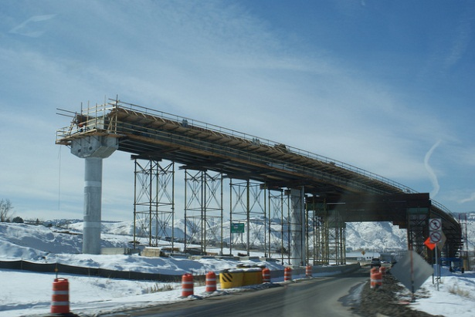
Conclusions
Pension transfers would become easier if …
… pension schemes cooperated better
… the scheme member could reach an informed decision
… the transfer process became more efficient

Slide 11
Discussion

Slide 12
Questions for discussion:
Do you see any other impediments to transferability? If so, which ones?
Are you aware of any other Good Practices to facilitate transfers? If so, which ones?
When changing jobs, do you think that people are sufficiently informed about their possibilities regarding pension rights transfer, and its implications?
Is more action needed at European level? What could EIOPA do to further facilitate transferability?

Slide 13
Thank you for your attention! Questions?
Alexandra de Jong
Expert
Consumer Protection and Financial Innovation
Alexandra.dejong@eiopa.europa.eu

Slide 14
References:
EIOPA Consultation Paper: https://eiopa.europa.eu/Pages/Consultations/Consultation-Paper-on-Good-Practices-on-individual-transfers-of-supplementary-occupational-pension.aspx
Call for Advice from COM to EIOPA (2 June 2014): https://eiopa.europa.eu/fileadmin/tx_dam/files/publications/otherdocuments/140520_DG_Letter_to_EIOPA_on__call_for_advice_portability.doc.pdf

Slide 15
COM Call for Advice
EIOPA asked to provide the COM with:
overview of the existing arrangements for transfers of acquired supplementary pension rights (domestic and cross-border)
“good” practices related to transfers
obstacles/difficulties affecting (or preventing) transfers
quantitative data on transfers of pension assets

Slide 16
Main impediments to transfers of pension rights
Requirements for transferring and receiving schemes
Information disclosure and advice
Costs and charges
Process
Identification of the receiving scheme especially for cross-border transfers
Calculation of the transfer value
Taxation
Capital pay-out

Slide 17
Good Practices:
Good Practice 1: Voluntary transfer agreements
Good Practice 2: Objective criteria for reasons to suspend a transfer incl. financial sustainability check of schemes
Good Practice 3: Same requirements for receiving schemes for domestic and cross-border transfers
Good Practice 4: Timeframes for in- and out- transfers

Slide 18
Good Practice 5: Content of information to scheme member
Good Practice 6: Systematic delivery of information
Good Practice 7: Online tool/portal with (additional) relevant information concerning scheme member’s transfer
Good Practice 8: Access to advice

Slide 19
Good Practice 9: Charges, if any, to reflect the actual work necessary
Good Practice 10: Direct communication between the schemes on transfer execution
Good Practice 11: Reasonable time limits for the execution of transfers
Good Practice 12: Member involvement reduced to request and decision on transfer

Slide 20
Good Practice 13: Identification of receiving scheme especially for cross-border transfers
Good Practice 14: Safeguarding the right to transfer over right to unilateral capital pay-out

